Slide 1
THE HAPPY CHURCH

Slide 2
Welcome Back !

Slide 4
Build a church
Each group is given a paper with parts of a church. They are to cut and make a church from the parts given within a minute .

Slide 5
HOW,WOW,
POW,CHOW!

Slide 6
How-Wow-Pow-Chow
Going around, ask every person in turn, “How, Wow, Pow, Chow?” They will share answers to all the following.
How: How are you doing right now?
Wow: Share a wow moment from last week.
Pow: Share a challenging thing that happened last week.
Chow: What was the best thing you ate last week?

Slide 7
We are all connected
Sitting in a circle, toss a ball of string to someone in the circle. Before tossing, share one highlight from this Happiness Group.
All of us depend on each other in this group to varying degrees. Depending on God and on His people, we can be closely connected, like in this web.

Slide 8
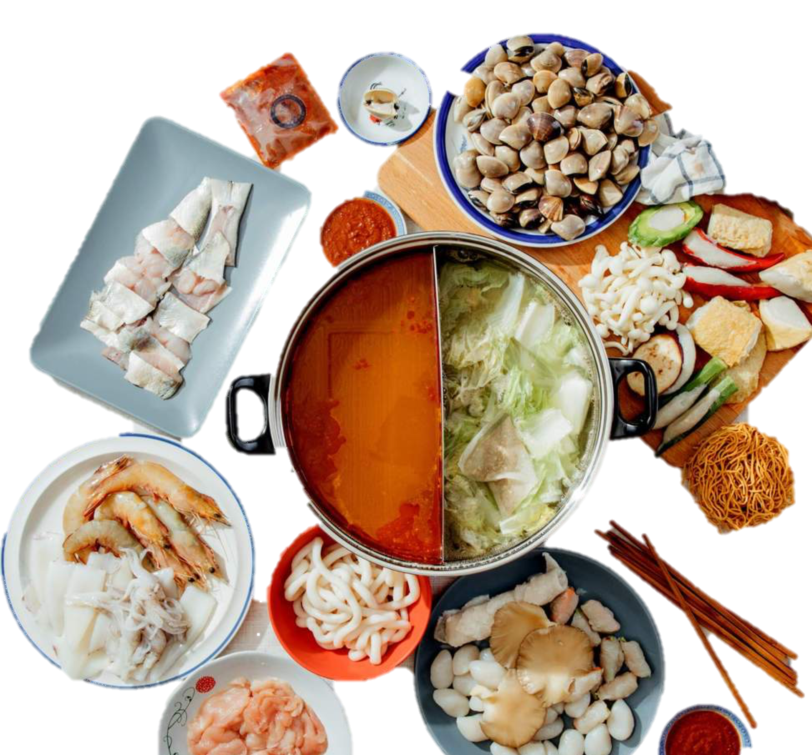
HAPPY STEAMBOAT

Slide 9
LET’S SING
Notes:
Sing Welcome to the Family (https://www.youtube.com/watch?v=mqVMT_IrPko) and go around shaking hands and exchanging hugs

Slide 10
GOD LOVES YOU GREATLY,
DO YOU KNOW THAT ?

Slide 11
HE DID NOT CREATE US TO BE ALONE

Slide 12
HE GIVES US COMMUNITIES

Slide 13
God’s answer for us
He offers us a relationship with Himself
God provided us with natural families
and sent His Son so we can be part of His family
Which is “The Church”

Slide 14
God’s answer for us
A Family, Fellowship, and the Body of Jesus Christ!

Slide 15
What is the Church?
A Christian community that responds to Jesus’ command to love one another (John 13:34-35)
The Body of Christ – (1 Corinthians 12:12-21)
No one is excluded

Slide 16
What is the Church?
A gathering of God’s people
The Body of Christ
Christ is the Head of the church
This shows His deep connection with the life of the church

Slide 17
JUST A GLIMPSE OF OUR HAPPINESS GROUP…
Picture of XFXZ

Slide 18
WHO IS THE CHURCH?
We are the CHURCH !

Slide 19
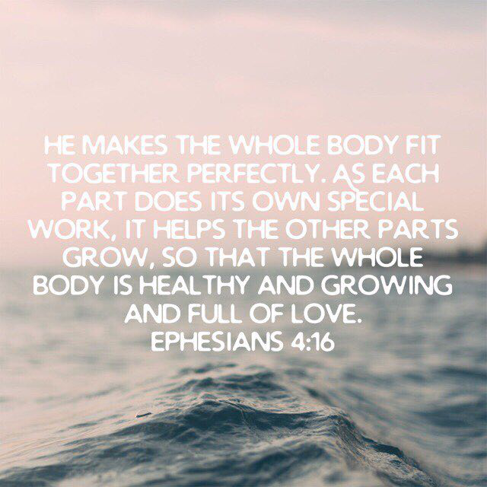
WE ARE LIKE A FAMILY AS WE BUILD EACH OTHER IN CHRIST, LOOK OUT FOR EACH OTHER & OVERCOME LIFE TOGETHER

Slide 20
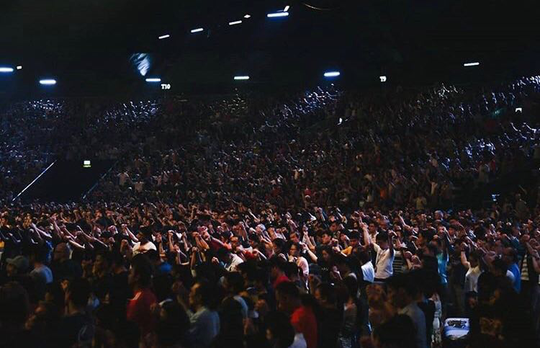
WE ARE PART OF A LARGER FAMILY

Slide 21
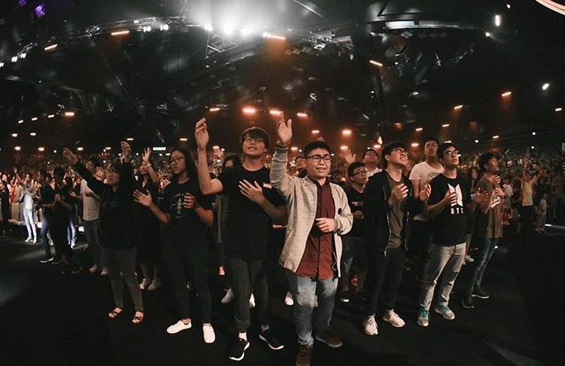
WHY DO WE KEEP SHARING ABOUT
THE TRUE HAPPINESS WE HAVE ?

Slide 22
YOU ARE VALUABLE TO THE CHURCH

Slide 23
A well known speaker started off his seminar by holding up a $50 bill. In the room of 200, he asked, "Who would like this $50 bill?" Hands started going up. He said, "I am going to give this $50 to one of you – but first, let me do this."

Slide 24
He proceeded to crumple the 50 dollar note up. He then asked, "Who still wants it?” Still the hands were up in the air. "Well," he replied, "what if I do this?"
He dropped it on the ground and started to grind it into the floor with his shoe. He picked it up, now crumpled and dirty.
"Now, who still wants it?" .

Slide 25
Still the hands went into the air. "My friends, you have all learned a very valuable lesson. No matter what I did to the money, you still wanted it because it did not decrease in value. It was still worth $50. Many times in our lives, we are dropped, crumpled, and ground into the dirt by the decisions we make and circumstances that come our way. We feel as though we are worthless; but no matter what happened or will happen, you will never lose your value.

Slide 26
Dirty or clean, crumpled or finely creased, you are still priceless to God and to His church. The worth of our lives comes, not in what we do or who we know, but by… WHO WE ARE. You are valuable in God’s eyes and to His church

Slide 27
The Bible says “we are His workmanship created in Christ Jesus for good works” [Ephesians 2:10]. You are God's one-of-a-kind masterpiece. There’ll never be another you.
If you don't believe it, look at your fingerprints. YOU HAVE INFINITE VALUE! You are special - don't ever forget it."

Slide 28
1. WE HAVE EXPERIENCED THIS GREAT LOVE AND WE WANT YOU TO HAVE IT TOO

Slide 29
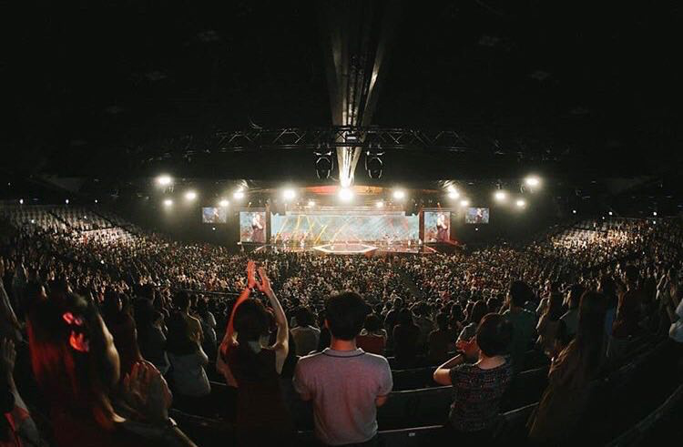
2. OHANA :
MEANS NO ONE GETS
FORGOTTEN OR LEFT BEHIND

Slide 30
THAT INCLUDES EVERYONE
WHETHER YOU HAVE NO PURPOSE IN LIFE ?
FACING PRESSURE ? CRYING IN SECRET ?
POOR AND BROKEN IN SPIRIT ? IN NEED OF HEALING ?
HURT ? BITTER ? LOST ? DISCOURAGED?

Slide 31
THE CHURCH IS LIKE A HOSPITAL
FOR THE SICK AND NOT THE PERFECT

Slide 32
IT IS A PLACE
WHERE THE SPIRIT RESTS,
A HOME TO THE SOUL

Slide 33
WHERE WE GATHER,WORSHIP GOD,
NURTURE AND BUILD UP THE SPIRIT

Slide 34
WE CARE FOR EACH OTHER
THROUGH THE LOVE OF GOD

Slide 35
SOMETHING THAT WAS SHARED AT OUR CHURCH…

Slide 37
WE SPOKE ABOUT…

Slide 38
“THE PERFECT FAMILY
UNDERSTANDS & EMBRACES ITS IMPERFECTIONS”.

Slide 39
“WE ARE ALL WORK IN PROGRESS”.

Slide 40
“THE PERFECT FAMILY” IS ONE THAT:
UNDERSTANDS ITS IMPERFECTIONS
& EMBRACES ITS IMPERFECTIONS

Slide 41
DO YOU WANT TO BE
PART OF THIS HAPPY CHURCH ?

Slide 42
DO YOU WANT TO
RECEIVE THIS GREAT LOVE TODAY ?
REPEAT THIS PRAYER AFTER ME
Notes:
Invite BESTs to say the Sinner’s Prayer to accept Christ

Slide 43
JOIN US THIS WEEKEND !!!
Notes:
Invite BESTs to the weekend services and give them invitation cards and/or information on the church services

Slide 44
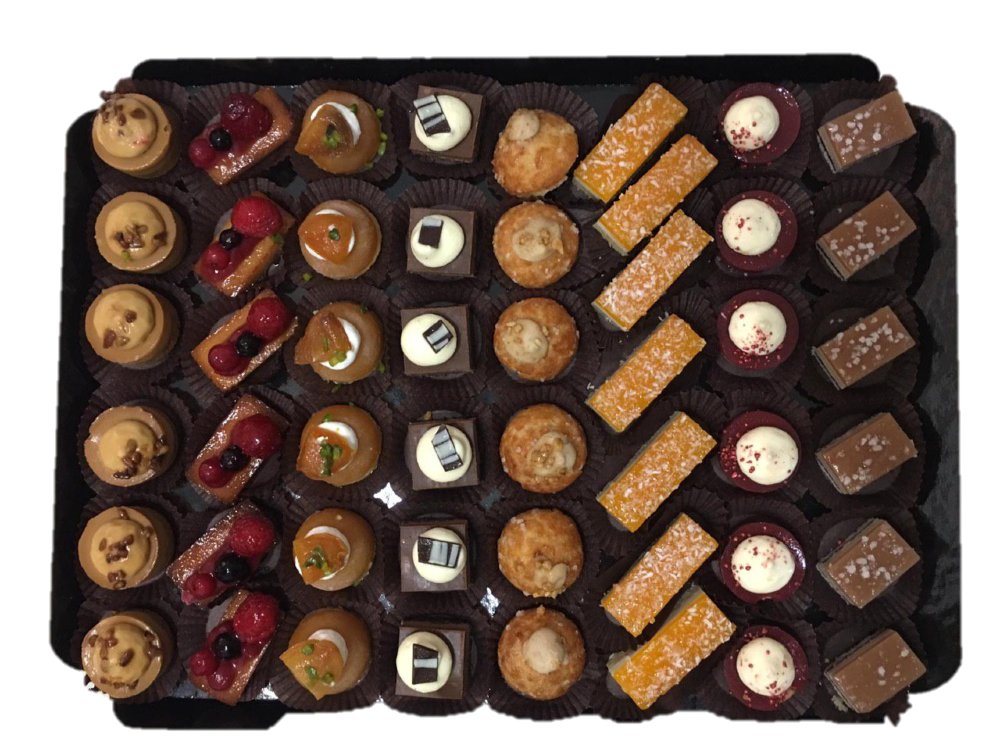
DESSERT

