Slide 1
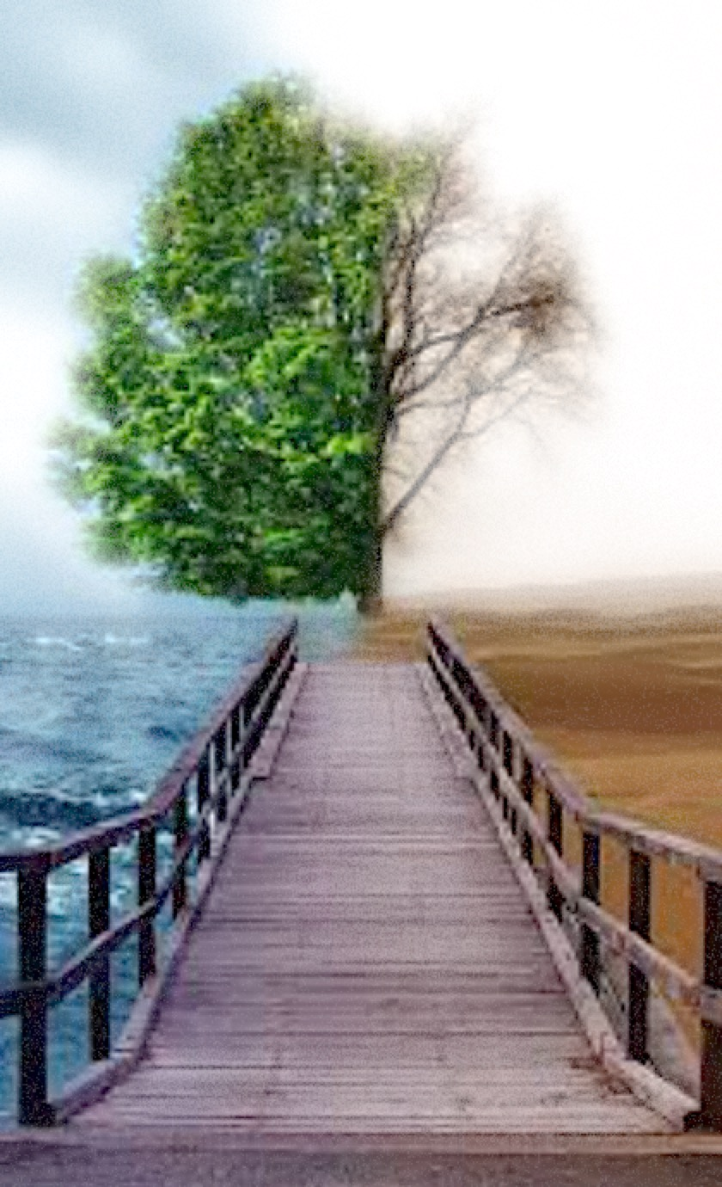
Happiness Connection

Slide 4
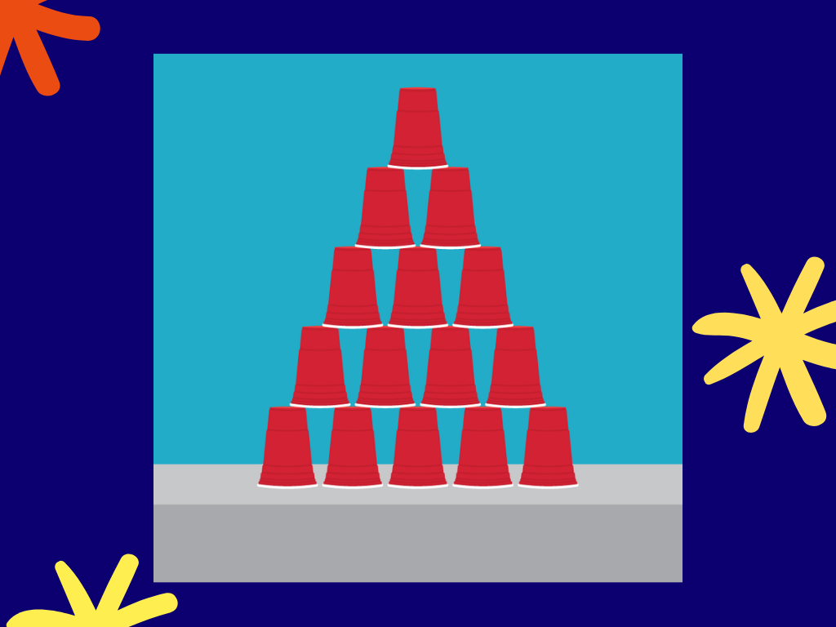

Slide 7
How has your week been?

Slide 8
Happiness Connection

Slide 9
What is true Happiness?

Slide 10
Love Earn $ Travelling Help others Buy big houses

Slide 11
Yet we are still Not Happy

Slide 12
Why are we still Not Happy?

Slide 13
1. We have a God-shaped vacuum in our hearts

Slide 14
Only God can fill that emptiness inside us

Slide 15
That’s why whatever we’re doing to find happiness, is really reaching out to Him

Slide 16
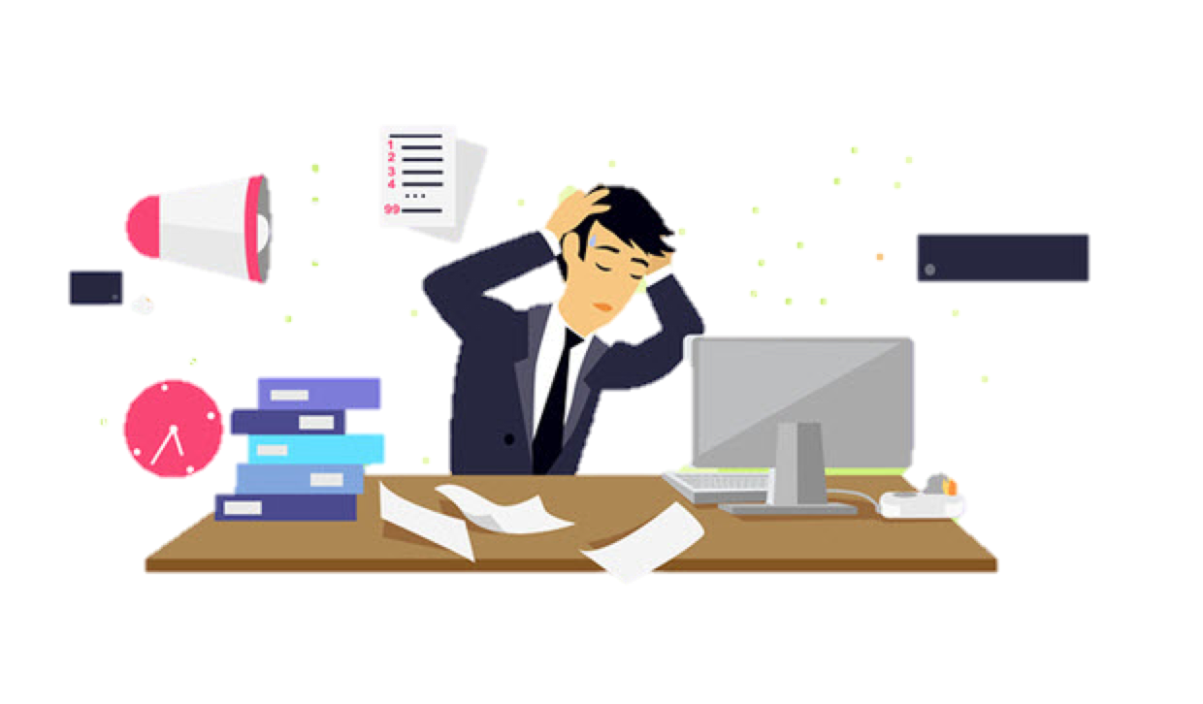
2. We want to have control in our lives but many things in life are beyond our control

Slide 17
Why do we want control? We want things our way, we want to live lives our way

Slide 18
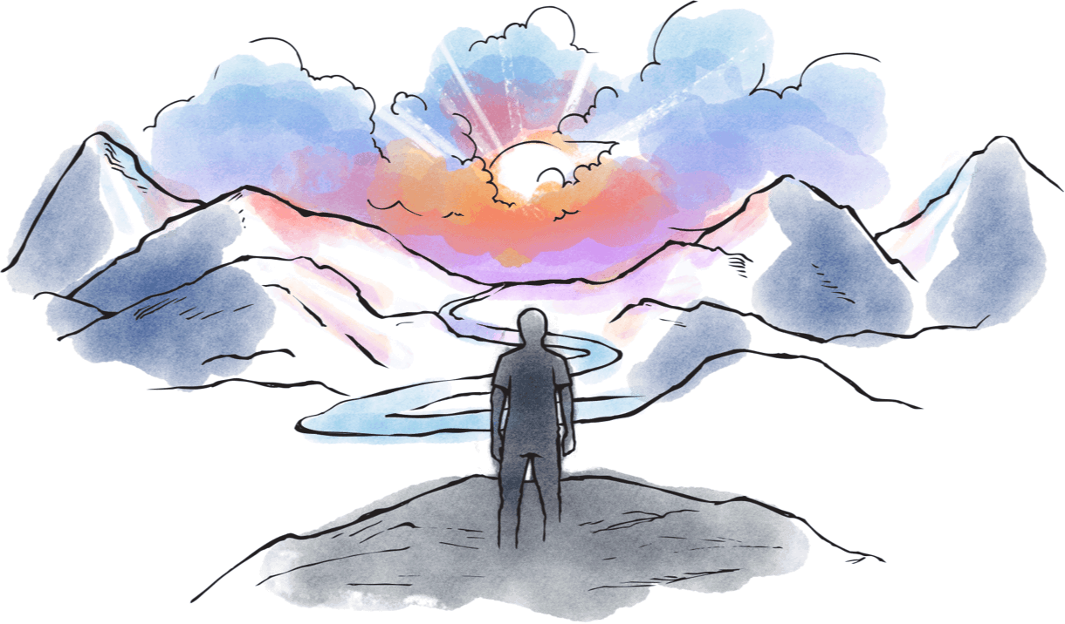
We fail to recognize that there is a God who created us

Slide 19
When we are not connected with God, there is a sense of emptiness within us

Slide 20
God cannot bear to see us continue in such a pathetic state

Slide 21
Therefore He sent His Son Jesus Christ to die on the cross for our sins, to save us. He is that bridge for us to God that brings true happiness.

Slide 22
When we have Jesus, then we can have true happiness, no matter what our circumstances,

Slide 23
despite us being frustrated with our weaknesses, always angry with ourselves for doing wrong things, despite uncertainty and anxiety towards our future or problems

Slide 24
true happiness, that is regardless of our situations and circumstances.

Slide 25
Many have the misconception that Christianity is a religion, but it’s actually a relationship with God.

Slide 26
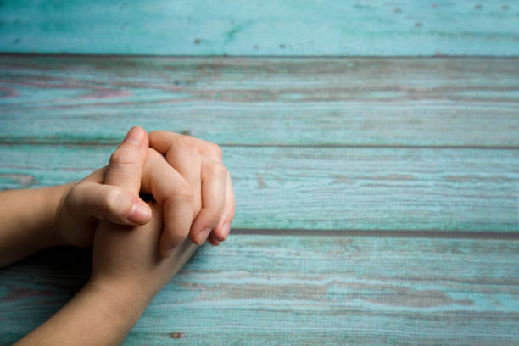
Two way communication we can speak to God and we can hear from God through prayer

Slide 27
Story telling time!

Slide 28
Story 1!
Notes:
Pre-arrange one of your members to share a testimony of answered prayers

Slide 29
Story 2!
Notes:
Pre-arrange another of your members to share a testimony of answered prayers

Slide 30
Brandon Soh’s Story
Notes:
Playback the baptism testimony of Brandon Soh from FCBC (https://www.fcbc.org.sg/about/baptism-testimony-videos/brandon-soh). He mentioned repeatedly that God answered his prayers to straighten up the mess in his life when he was in the lock-up, and his prayers for a cell and for a full-time job after his release from prison.

Slide 31
my story… there are many things I cannot control in life
Notes:
Sometimes God may not even answer my prayers the way I want it, but I know that God is in control and working things out for my good. Just like the story of the heart surgeon that follows.

Slide 32
The Story of the Heart Surgeon

Slide 33
The Heart “Tomorrow morning,” the surgeon began, “I’ll open up your heart...” “You’ll find Jesus there,” the boy interrupted. The surgeon looked up, annoyed. “I’ll cut your heart open,” he said, “to see how much damage has been done...” “But when you open up my heart, you’ll find Jesus in there.”

Slide 34
The surgeon looked to the parents. “When I see how much damage has been done, I’ll sew your heart and chest back up and I’ll plan what to do next.” “But you’ll find Jesus in my heart. The Bible says He lives there. The hymns all say He lives there. You’ll find Him in my heart.” The surgeon had had enough. “I’ll tell you what I’ll find in there – damaged muscles, low blood supply, and weakened vessels. And I’ll find out if I can make you well.”

Slide 35
“You’ll find Jesus there too. He lives there.” The surgeon left. He sat in his office and recorded his notes from the surgery, “...damaged aorta, damaged pulmonary vein, widespread muscle degeneration. No hope for transplant, no hope for cure. Therapy: painkillers and bed rest. Prognosis:” He paused, “death within one year.” He stopped the recorder... “Why?” he asked aloud. “Why did You do this? You’ve put him here; You’ve put him in this pain. And You’ve cursed him to an early death. Why?”

Slide 36
The Lord answered and said, “The boy, my lamb, was not meant for earth for long, for he is a part of my heavenly flock, and will forever be. Here in my heavenly flock, he will feel no pain, and will be comforted as you cannot imagine. His parents will one day join him here, and they will know peace, and my flock here will continue to grow.” The surgeon’s tears were hot, but his anger was hotter, “You created that boy, and You created that heart. He’ll be dead in months. Why?”

Slide 37
The Lord answered, “The boy shall come to heaven, for he has done his duty: I did not put him on earth to lose him, but to retrieve a lost lamb, you.” The surgeon wept. He sat beside the boy’s bed; the boy’s parents sat across from him. The boy awoke and whispered, “Did you cut open my heart?” “Yes,” said the surgeon.

Slide 38
“What did you find?” asked the boy. “I found Jesus there,” said the surgeon.

Slide 39
my story… The confidence I can have is that God is in control and there is always hope through it all.

Slide 40
You can have that too. Will you believe? Let’s PRAY !!!
Notes:
Lead BESTs in the Sinner’s Prayer

Slide 41
Philippians 4:6-7 Don’t fret or worry. Instead of worrying, pray. Let petitions and praises shape your worries into prayers, letting God know your concerns. Before you know it, a sense of God’s wholeness, everything coming together for good, will come and settle you down. It’s wonderful what happens when Christ displaces worry at the center of your life.
Notes:
God wants to give us abundant life, peace and joy. He tells us not to be anxious about anything. By faith, we pray, ask and give thanks, and He will give us peace.
God will hear our prayers and answer according to His time and will. There is no reason to be worried. Just trust and rely on Him. Many here have been praying for you quietly daily, for you to receive this blessing. And you can have this blessing today, if you say today, “I am willing, I want to believe, I want to be connected with God who is the source of true happiness.” For some of you it is connecting back again, you were connected before but you grew distant from God but you know God has been pursuing you and today you want to commit your life to Him again. I invite you to place one hand on your heart, and with all eyes closed in this place, repeat this prayer after me, “Dear Lord Jesus, thank you for bringing me here today. I believe this is a start of a wonderful relationship with you, I want to know You. I believe in You and I am willing to accept you as my personal Lord and Savior. Please bless me with peace, joy and hope. In Jesus’ name I pray, amen. And amen means “let it be so” meaning this blessing prayed will come on you and your family.

Slide 42
Let’s Talk to God about Our Needs in Prayer Now
Notes:
Break into small groups and pray for the BESTs

