Slide 1
Welcome to Our Happiness Group
Notes:
Session 1: True Happiness
Key points for sharing:
Everyone desires a happy life, therefore we want to know what makes people unhappy and how to achieve happiness.
The answer is knowing that Jesus is true happiness
-Friends, welcome to our gathering .

Slide 2
True Happiness

Slide 3
Happiness is…
Knowing One
Another !

Slide 4
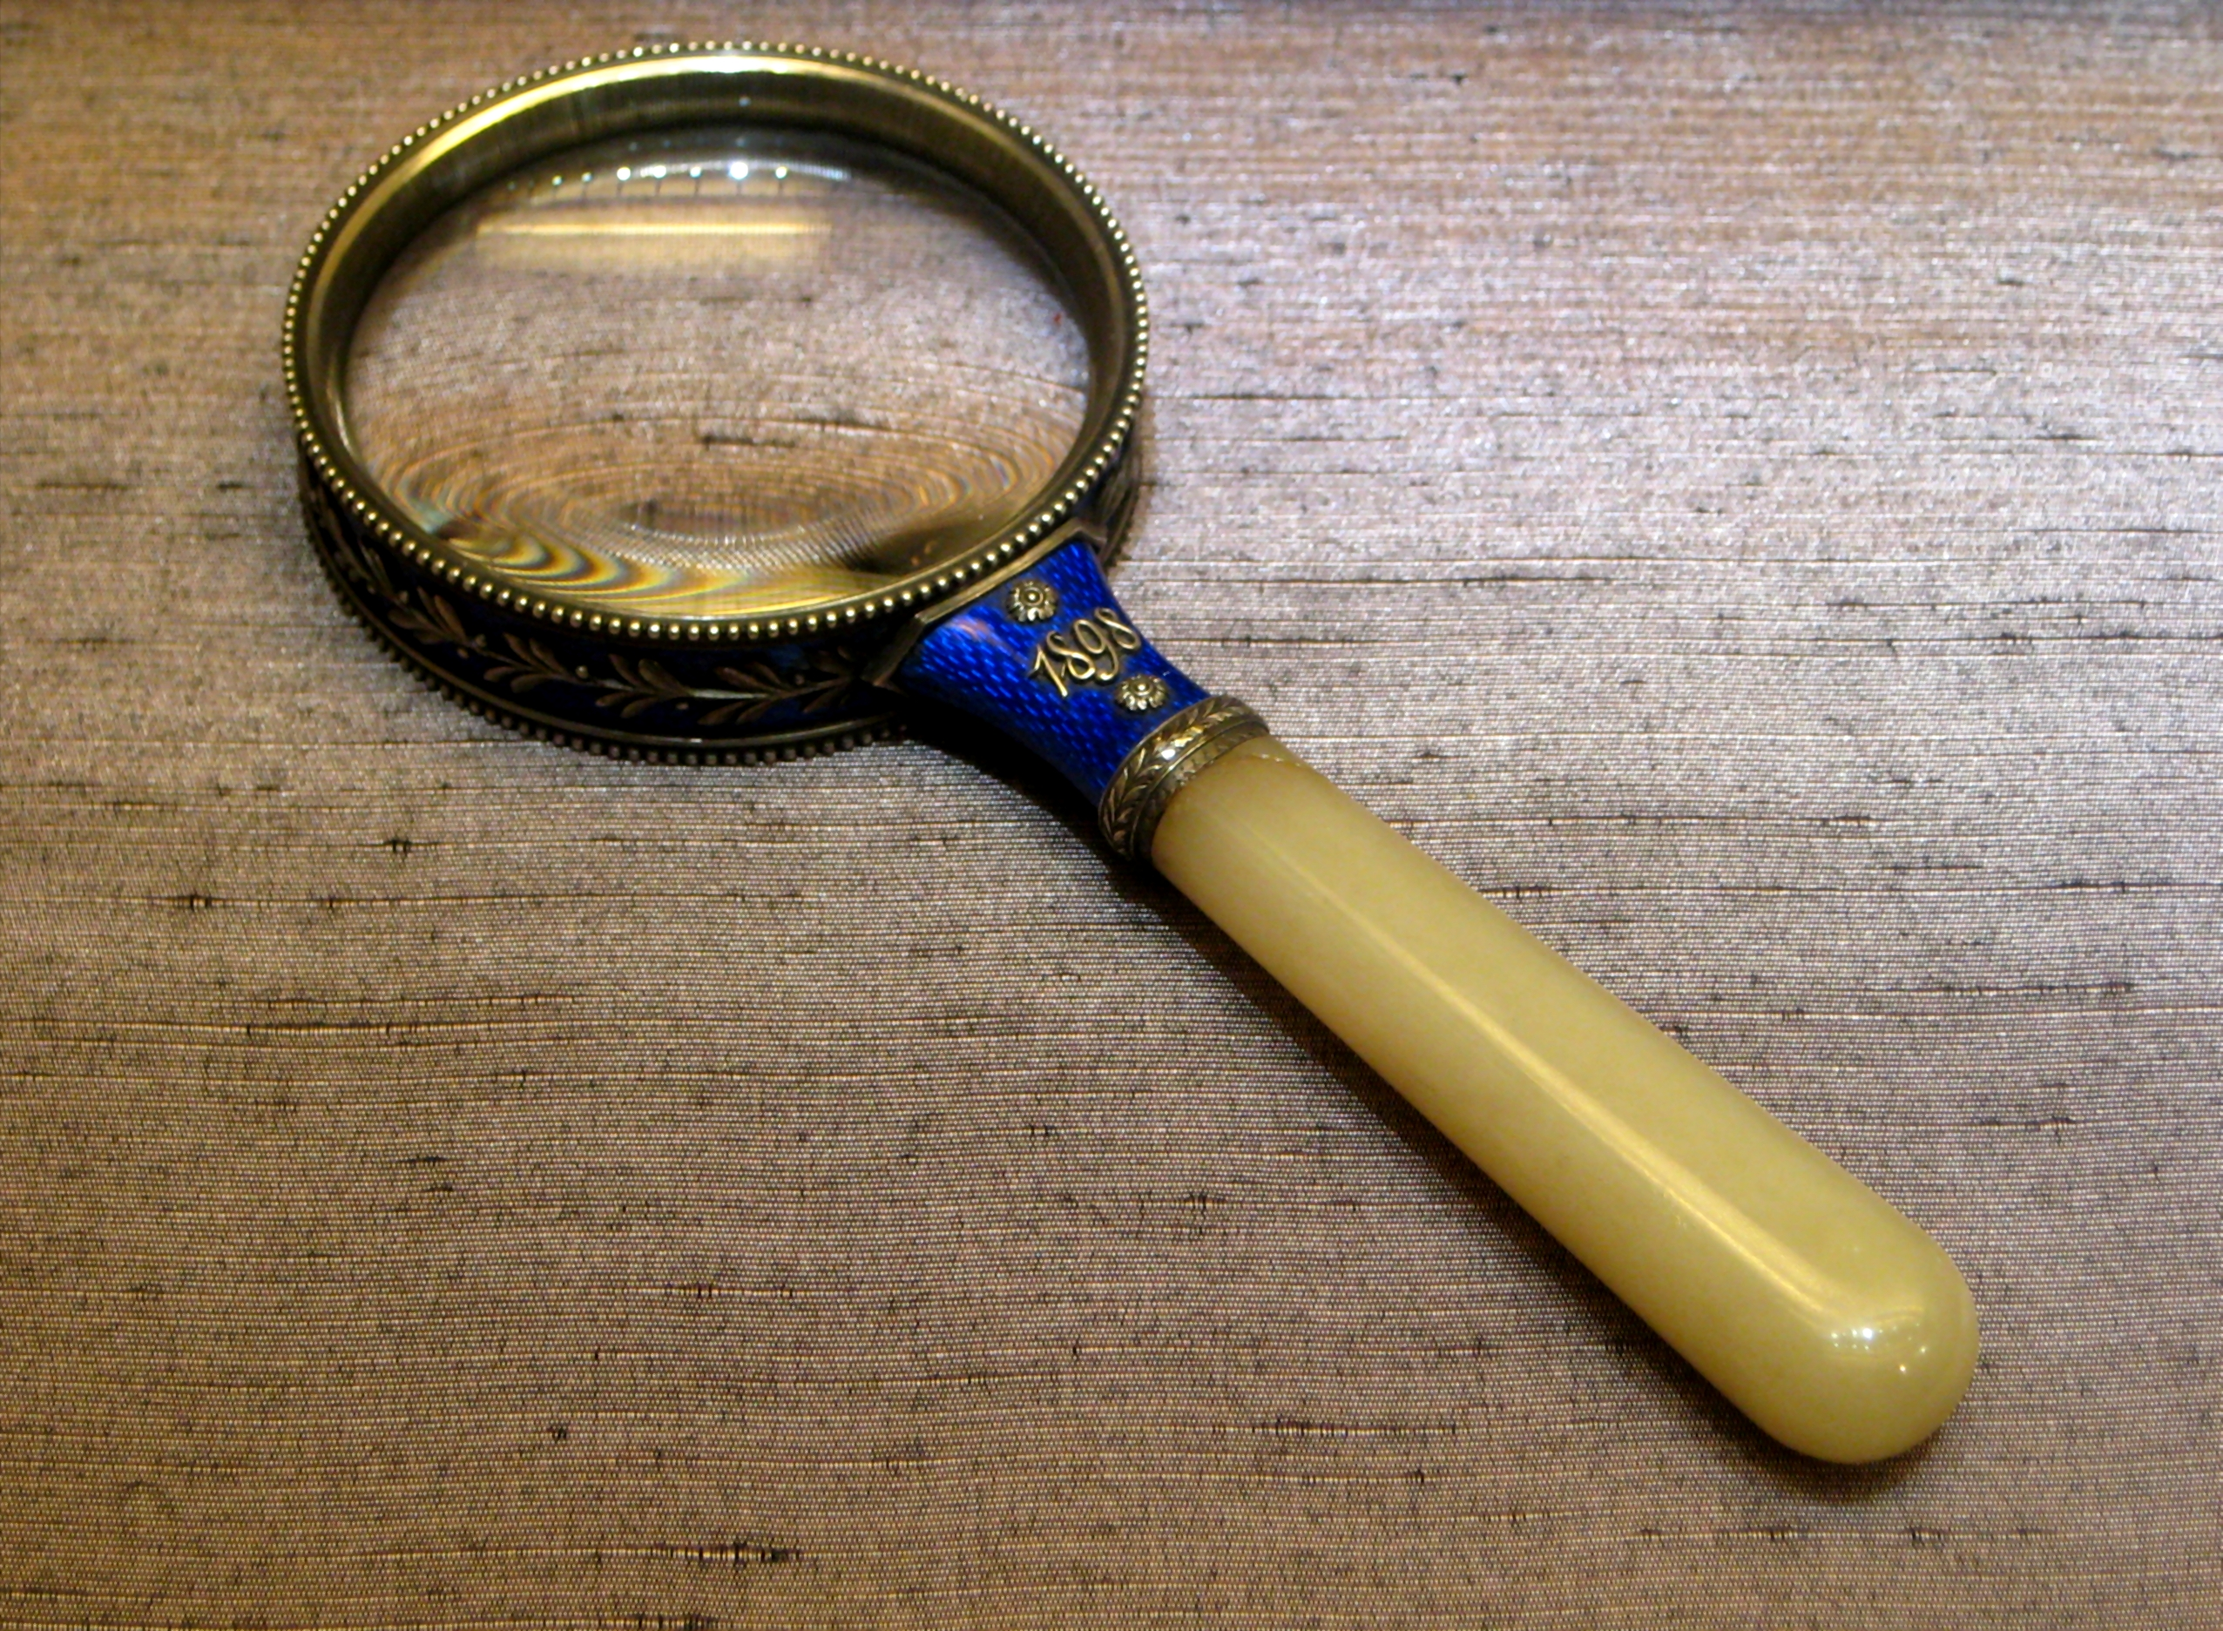
Whodunit?

Slide 5
Each one writes something interesting you’ve done before on a note card, e.g., skydiving, lived in 10 different cities, drank 4 litres of water in 5 mins — the sillier the better

Slide 6
Put the note cards into a bag, give it a good shake, and each person draws a card and read aloud. The reader is to guess "who done it” and why they came to their conclusion.

Slide 7
Happiness is…
Sweet!

Slide 8
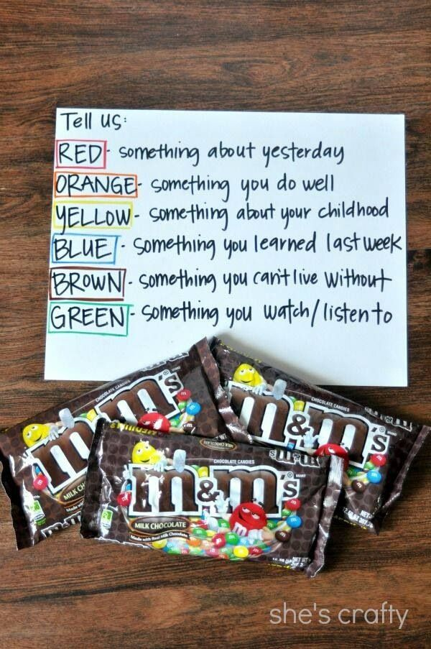
M&M's !
Notes:
Ice breaker 1:
Pass a bag of M&M’s around and tell everyone to take a few. Then, before they eat them ask them to share something for every M&M they took, according to the colours of their M&Ms.

Slide 9
I’ve got peace like a river
Notes:
Lead in singing “I’ve Got peace like a river in my soul”
You can use YouTube https://www.youtube.com/watch?v=N2R4D6qhaD8&gl=SG&hl=en-GB

Slide 10
I’ve got the joy joy joy joy

Slide 12
Happiness is…
Connecting with
the One Who
loves me!

Slide 13
Happiness Story 1
Notes:
Testimony 1 – arrange for someone to share a testimony on how finding Jesus brought joy and happiness to his life or playback the YouTube clip of Alexander the Great’s last wishes https://www.youtube.com/watch?v=KD-agMT-5uk

Slide 14
Happiness Story 2
Notes:
Testimony 2 – arrange for someone else to share a testimony on how finding Jesus brought joy and happiness to his life or playback a YouTube clip of Nick Vujicic

Slide 15
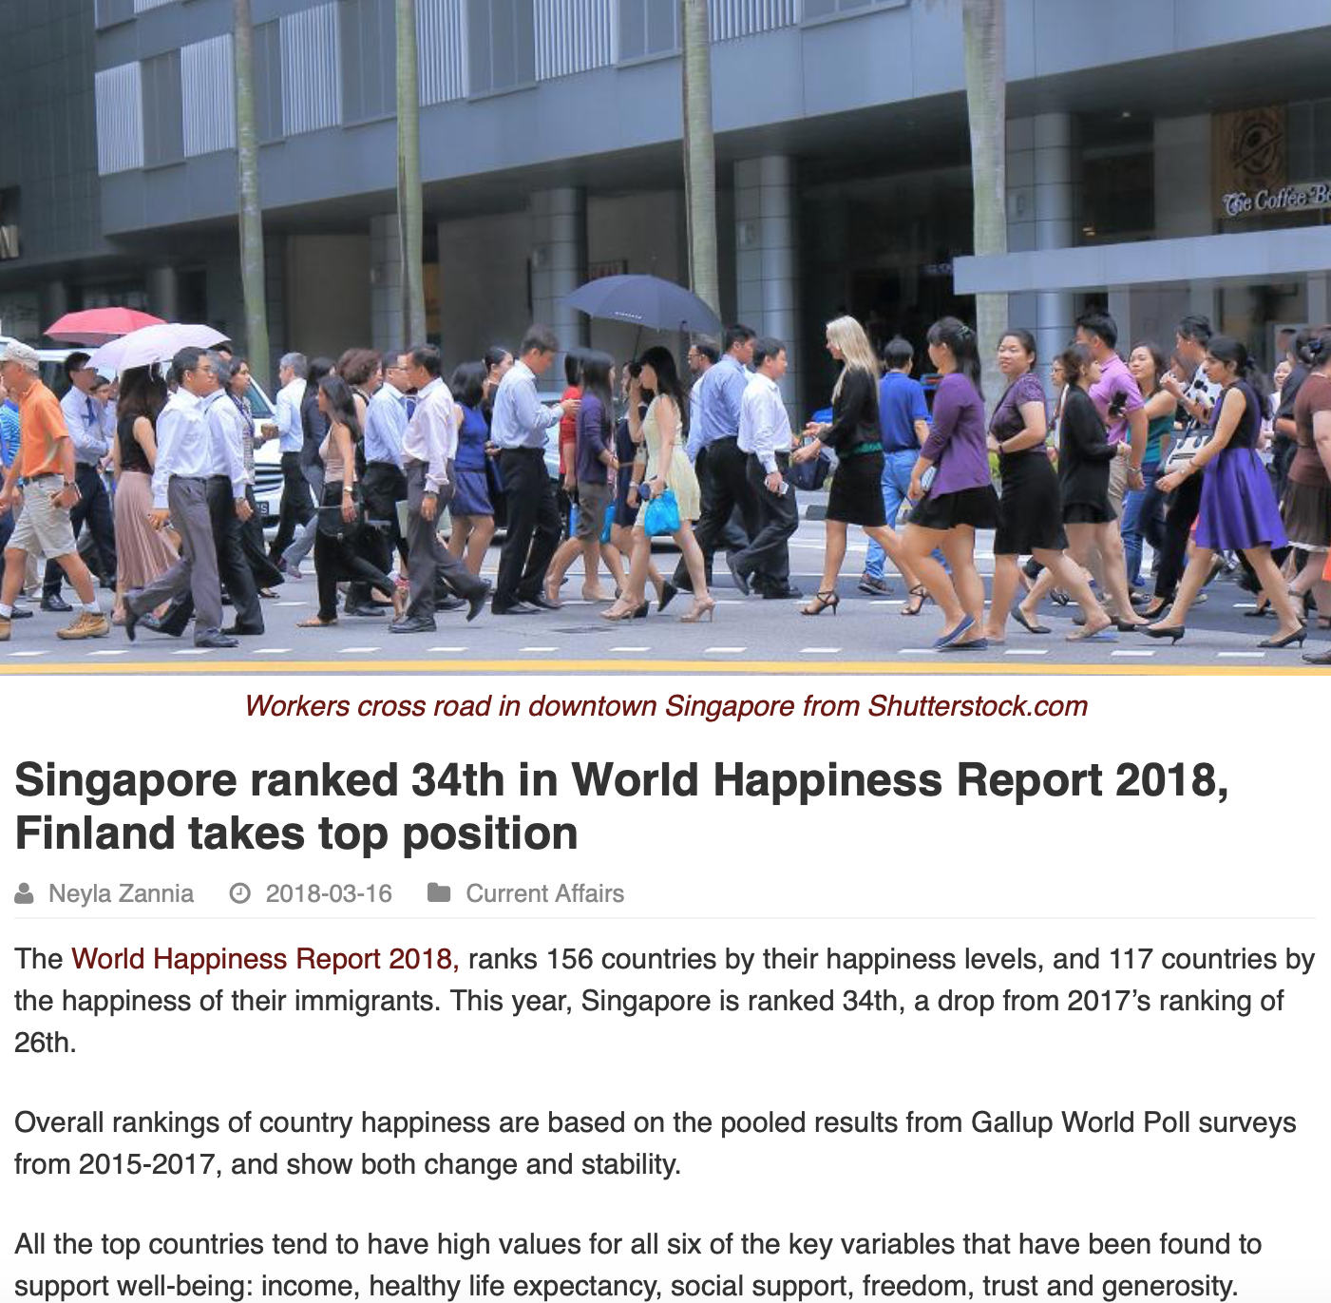

Slide 16
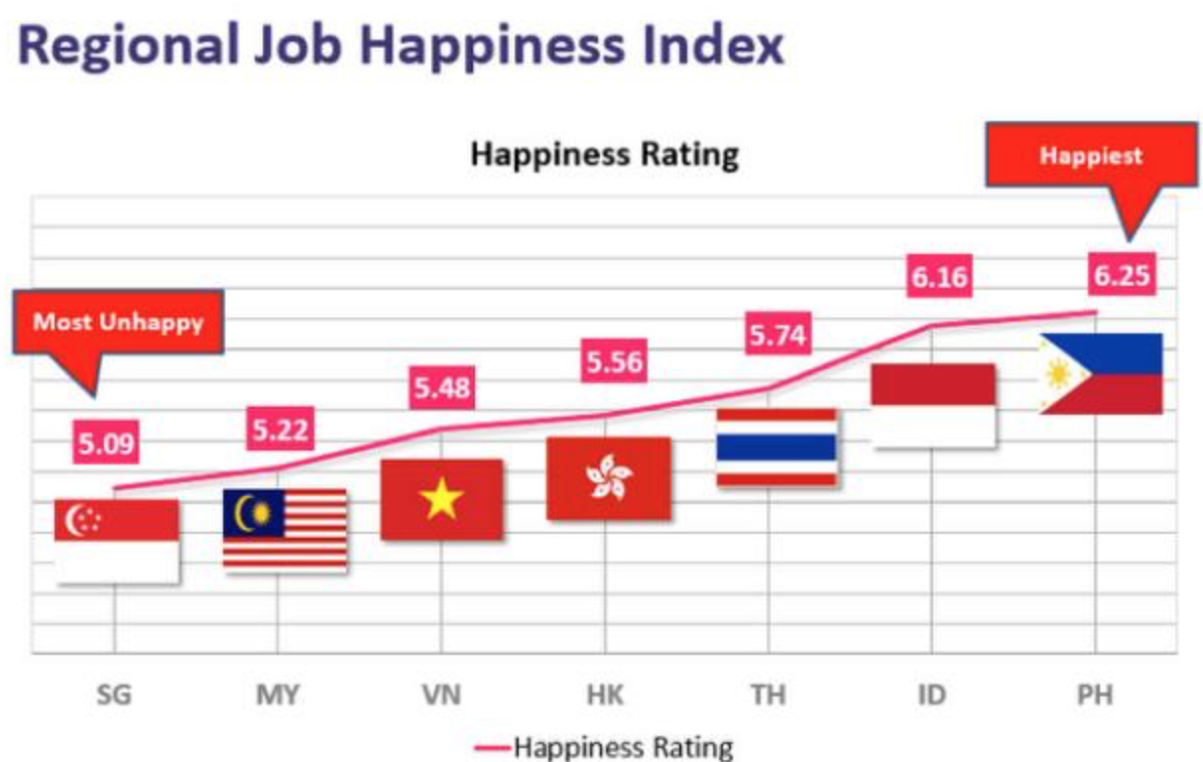

Slide 17
Why are many Not Happy?

Slide 18
“For whom am I toiling,” he asked, “and why am I depriving myself of enjoyment?” Ecclesiastes 4:8

Slide 19
Everyone longs for a happy and blessed life

Slide 20
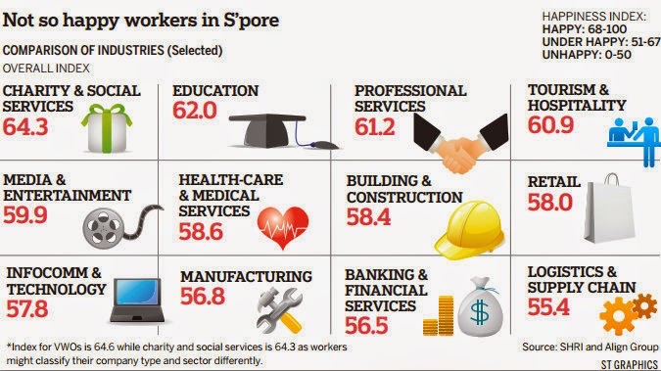
But lives in unhappiness because life is not always smooth sailing

Slide 21
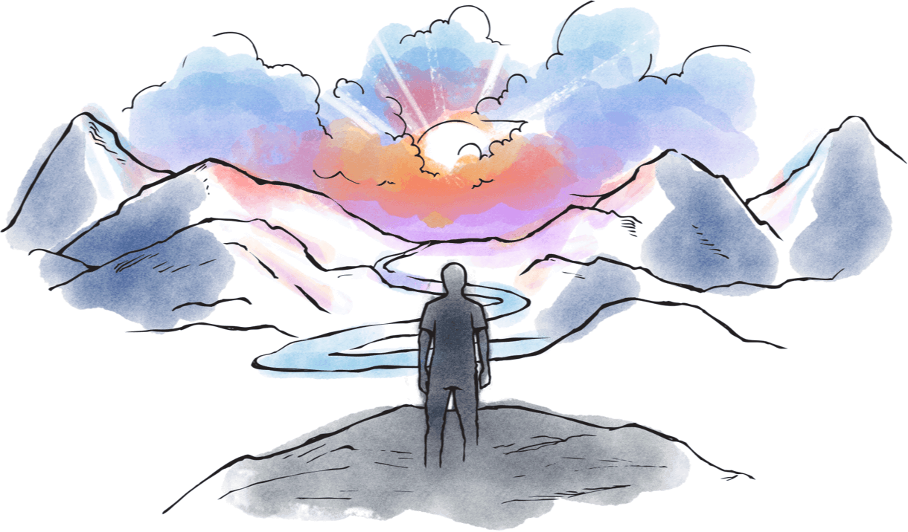
We turn to fortune telling, divination, do good deeds and religious acts, but still cannot solve the problem

Slide 22
Like people who have lost our way

Slide 23
There is only one way and if we find it, our burdens will be removed

Slide 24
I have found it in Jesus He is the only way, the power to forgive me, to carry my burdens and give true rest to my soul

Slide 25
HAPPINESS VIDEO
HAPPINESS VIDEO
Notes:
Playback this video and briefly explain that God made us to be happy and joyful but sin robs us of joy and happiness and share how you yourself believed in Jesus and found joy and true happiness even in times of problems and troubles. Then lead in the Sinner’s Prayer.

Slide 27
HAPPINESS is when you see someone happy

Slide 28
HAPPINESS is being able to see you again at our next meeting

Slide 29
NEXT MEETING OF HAPPINESS GROUP: The Whole Truth ! See you

